Slide 1

Recipe Site Traffic Case Study
Muhammad Atef

Slide 2
Business Problem
Currently the Product Manager chooses their favorite from a selection and displays that on the home page.
They have noticed that traffic to the rest of the website goes up by as much as 40% if they pick a popular recipe. But they don’t know how to decide if a recipe will be popular.
“More traffic means more subscriptions so this is really important to the company. ”

Slide 3
Business Goals
To increase website traffic by displaying popular recipes on the homepage.
This leads to increase subscriptions which is essential for the business
To use data science to predict which recipes will lead to high traffic and correctly predict high traffic recipes 80% of the time.

Slide 4
Data Validation
Checked the data against the given description:
1- high_traffic has many ‘NULLs’ and ‘High’ that means not high and high:
change “nan” to “Low”
2- servings is not Numeric as there are “as a snack” extra part in only 3 rows:
remove the substring “as a snack”
3- There are 52 missing values in columns ['calories', 'carbohydrate', 'sugar', 'protein']
which represents about 5% of the dataset:
replacing them with the mean of data.

Slide 5
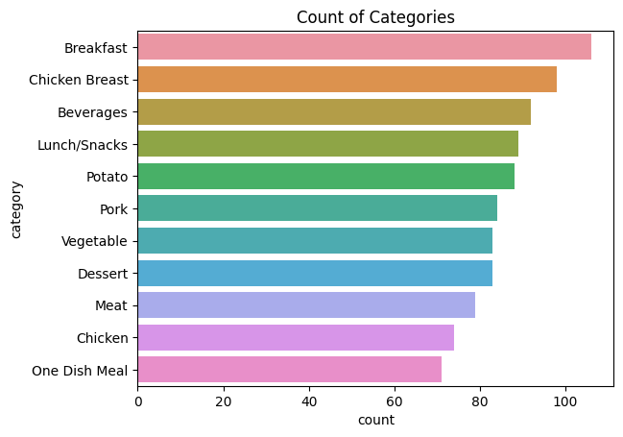
Data Visualization
The number of Breakfast is the highest number posted.
One dish meals are the least number posted

Slide 6
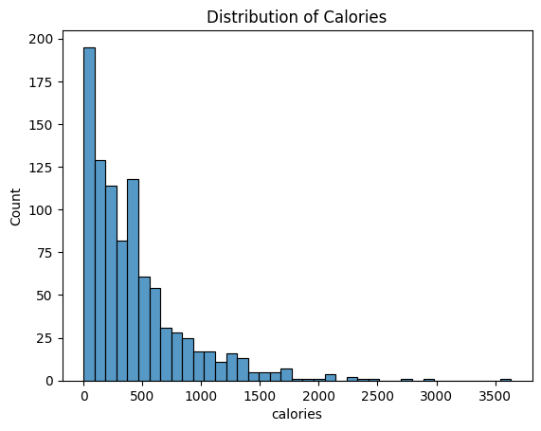
Data Visualization
The distribution of calories posted is right-skewed
There are outliers
[Data points > 2500cal]

Slide 7
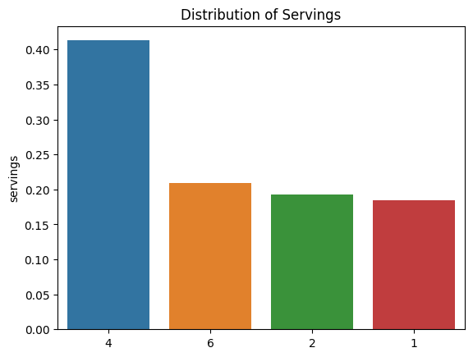
Data Visualization
The number of 4-servings is the highest number posted.
The number of 1-servings is the least number posted.

Slide 8
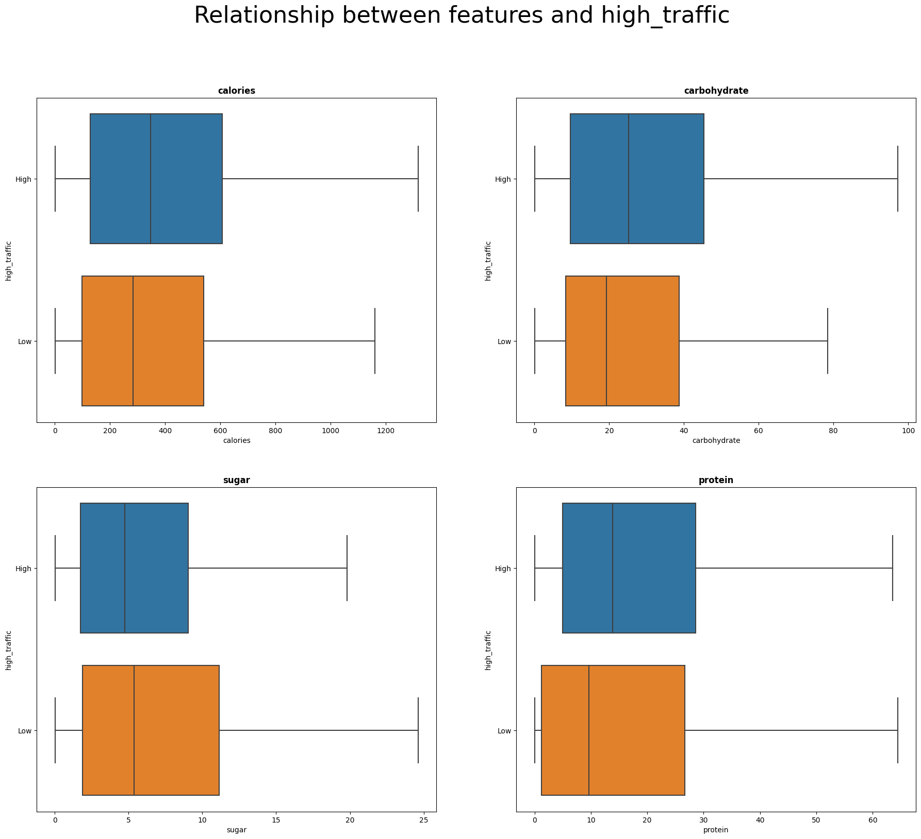
Data Visualization
We can summarize that
The more calories the recipe, the more traffic
The more carbohydrate the recipe, the more traffic
The less sugar the recipe, the more traffic
The more protein the recipe, the more traffic

Slide 9
Is this difference a real difference or by chance?
Subtract mean of high-traffic calories & mean of low-traffic calories = 65.37
The Hypothesis:
Null Hypothesis (H0): mean for High-traffic calories <= mean for Low-traffic calories
Alternative Hypothesis (H1): mean for High-traffic calories > mean for Low-traffic calories
Using T-test:
- p-value = 0.012 and threshold= 0.05
- so, we conclude (Mean of Calories for high traffic > Mean of Calories for Low traffic)
We can summarize that the more calories the recipe, the more traffic

Slide 10
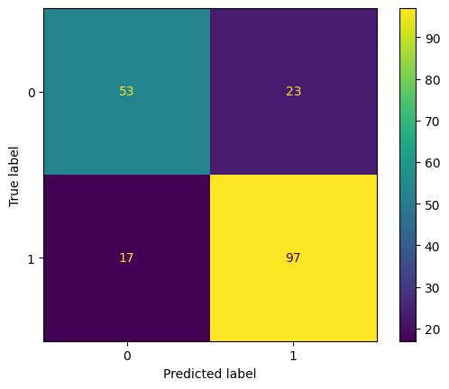

Model Development
This a classification problem (high / low)
Fitting a comparison model:
Using RidgeClassifier, it can be significantly faster than LogisticRegression
Score of model = 79%
Fitting a comparison model:
Using RandomForestClassifier, it can be more accurate than DecisionTree
Score of model = 78%

Slide 11
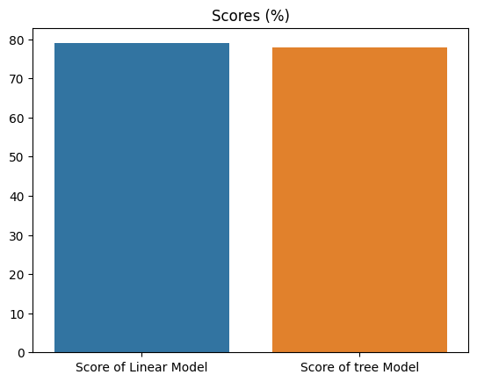
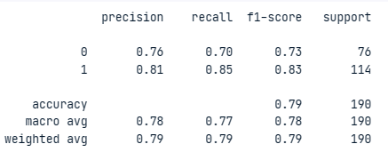
Model Evaluation
The Linear Model more accurate than the Random Forest in both accuracy and recall score
Classification Report for Linear Model

Slide 12
Business recommendation
the business should implement the model since it can identify more than 80% of the high traffic generating recipes
it is always a good practice to retrain the model with more data to improve its performance, in addition to capturing any changes in the customers behavior
I recommend:
Iteratively improving the model over time with:
additional features
additional observations
screening more models and preprocessing techniques
Utilize the current model as it’s shown to meet targets and provide business value, time to put the model into production.

